Slide 1
TECHNICAL WRITING PROCESS
Technical Business Writing
Department of Computer Science

Slide 2
TECHNICAL WRITING PROCESS
Prewriting
Writing
Rewriting

Slide 3
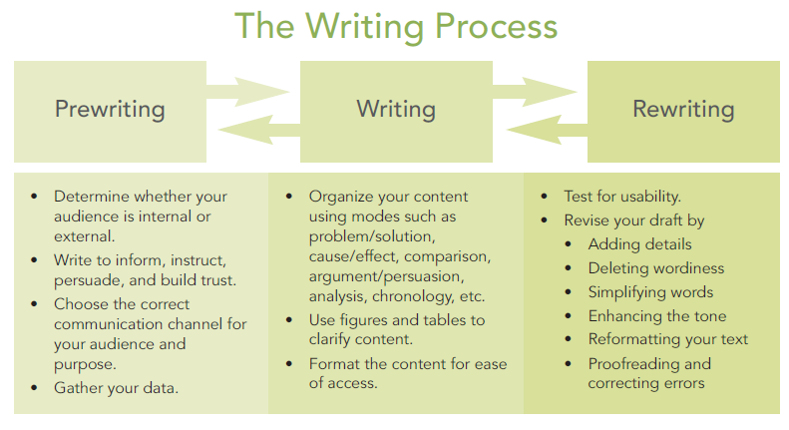

Slide 4
1. PREWRITING

Slide 5
PREWRITING
Plan your communication
Spending quality time , prior to writing
Generating information
You will get nowhere without prewriting

Slide 6
HOW TO PREWRITE
Examine your purpose
Determine your goals
Consider your audience
Gather your data
Determine how the content will be provided

Slide 7
1. EXAMINE YOUR PURPOSE
Know why you are communicating
Is your motivation internal or external?
INTERNAL MOTIVATION: If you have decided to write on your own accord.
EXTERNAL MOTIVATION: If you have been asked to write the document.

Slide 8
2. DETERMINE YOUR GOALS
Are you communicating to persuade an audience to accept your point of view? (persuade)
Are you communicating to instruct your audience by directing actions? (instruct)
Are you communicating to inform an audience of facts, concerns, or questions you might have? (inform)
Are you communicating to build trust and rapport by managing work relationships? (build trust)
(These goals may overlap)

Slide 9
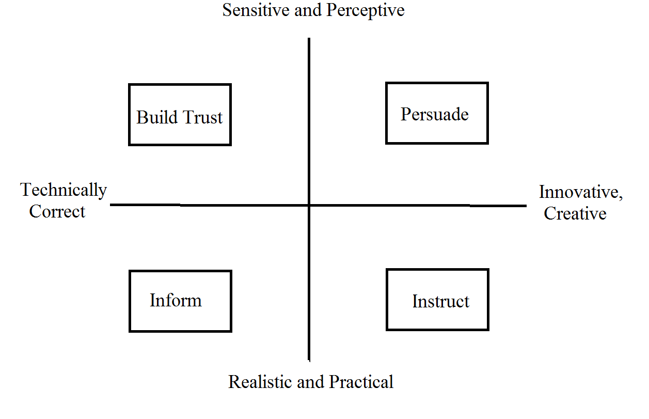
COMMUNICATION GOALS

Slide 10
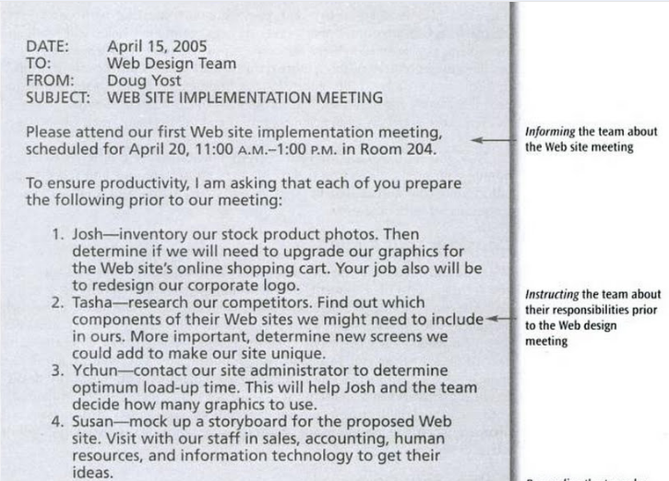

Slide 11
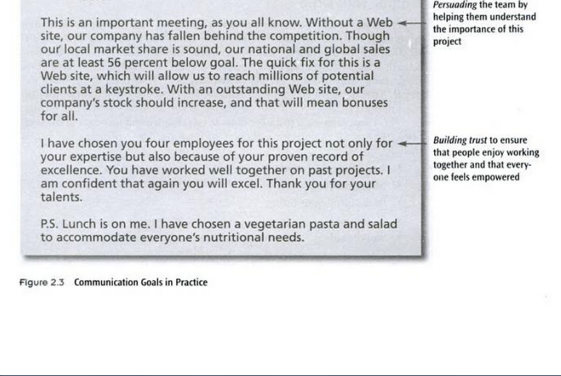

Slide 12
COMMUNICATING TO PERSUADE
COMMUNICATING TO PERSUADE: You need to be persuasive if your goal in writing is to change the opinion of others. To change opinion of others. For example, to write a proposal, a brochure, or a flier to sell a product
COMMUNICATING TO INSTRUCT: Instructions play an important role in technical communication activities. For example, you may feel the need to write email providing instructions for correctly following procedures.

Slide 13
COMMUNICATING TO INFORM: You often write emails or letters to inform. For example a letter of inquiry will inform a vendor about questions you might have regarding their service.
COMMUNICATING TO BUILD TRUST: Building rapport( empathy, understanding, connection, and confidence) is an important component of communication.

Slide 14
3. CONSIDER YOUR AUDIENCE
What you say and how you say is greatly determined by your audience
Are you speaking to high-tech audience? Low-tech audience? Or lay audience?
You will not write the same way to your boss as you would to your subordinates.

Slide 15
4. GATHER YOUR DATA
The next step after audience analysis is to decide what to say
You can gather data by:
  Answering the reporters questions
  Mind mapping
  Brainstorming or listing
  Outlining
  Storyboarding
  Creating organization charts
  Flowcharting
  Researching

Slide 16
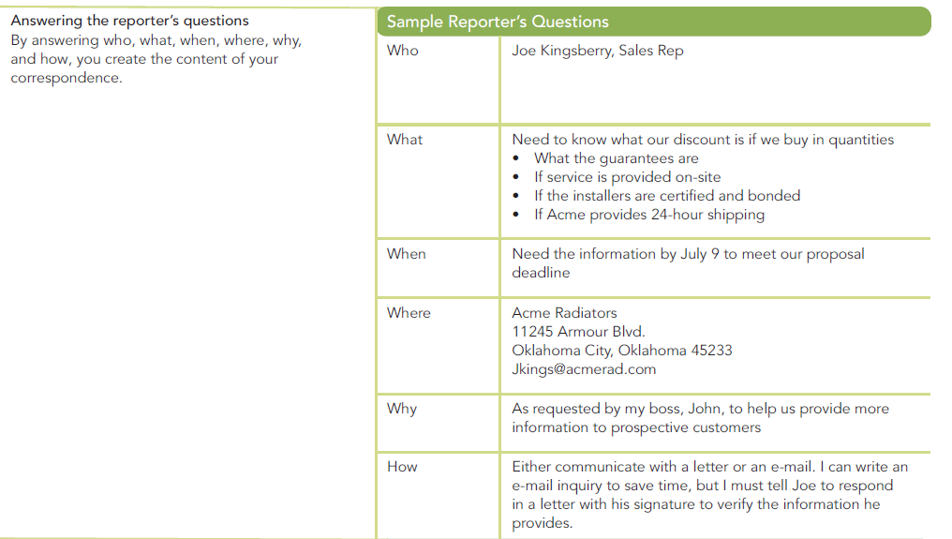

Slide 17
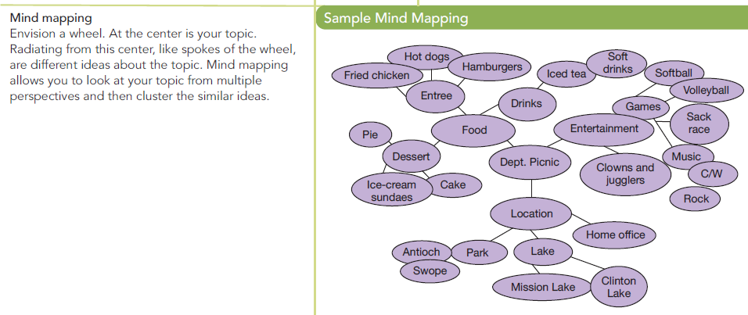

Slide 18
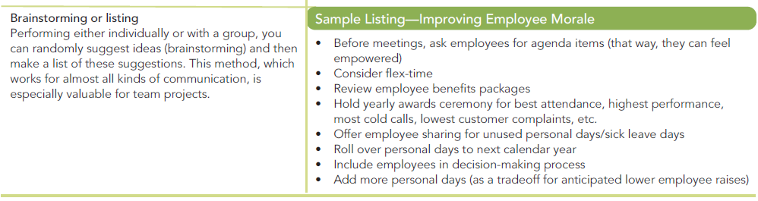

Slide 19
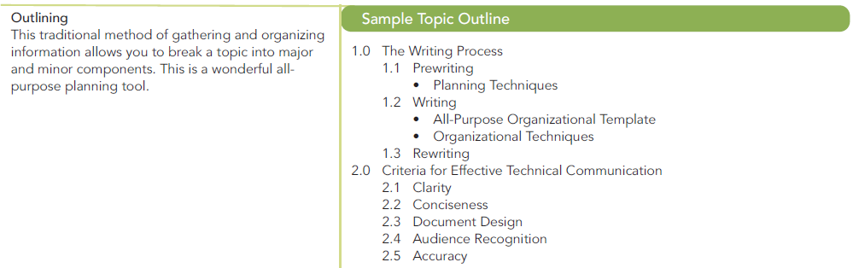

Slide 20
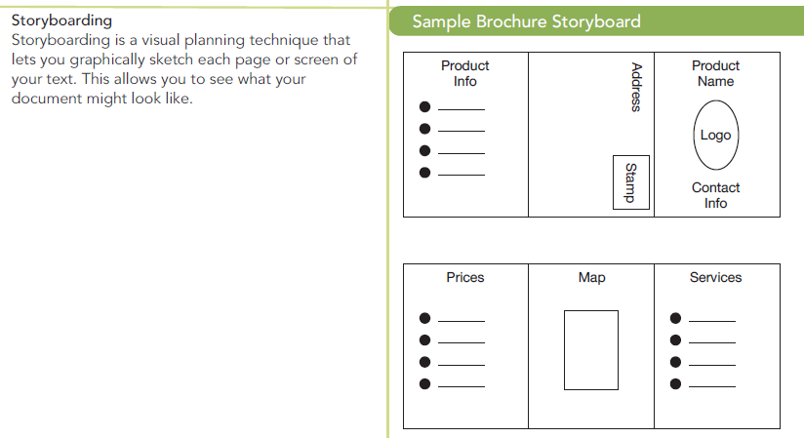

Slide 21
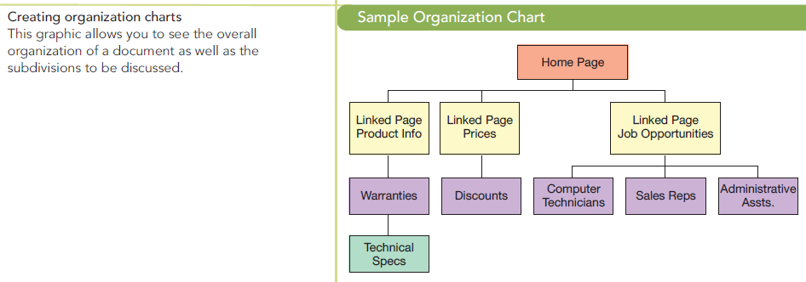

Slide 22
5. DETERMINE HOW THE CONTENT WILL BE PROVIDED
Decide the best way to convey your message
SINGLE SOURCING: Single-sourcing is the development of information content in a form that can conveniently be the basis for other forms of content. For example, text prepared for a printed book might be prepared in a form that could also be used without additional authorial involvement or adaptation.

Slide 23
2. WRITING

Slide 24
Writing lets you package the data
Packaged in such a way that the readers can follow your train of thoughts readily and can easily access your data.
Writing the draft lets the thoughts be organized in some logical and easy to use pattern.
For a better draft, the writer must organize and format the text.

Slide 25
ORGANIZATION
Spatial order
Chorological order
Order of Importance
Comparison/Contrast
Problem/Solution

Slide 26
FORMAT
Margins
Font size
Font style
Division
Headings
Sub-headings
bullets

Slide 27
3. RE-WRITING

Slide 28
Re-writing lets you perfect your text
It refines, hones, sculpt, and polishes the draft
Revise to:
  Add any missing detail for clarity
  Delete dead words and phrases for conciseness
  Simplify unnecessarily complex words and phrases to allow for easier understanding.
  Move around information(cut and paste) to ensure that your most important ideas are emphasized.
  Reformat (using highlighting techniques) to ensure reader-friendly ease of access.
  Enhance the tone and style of the text.
  Correct any errors to ensure accurate grammar and content

Slide 29
Technical Writing Process & Product
Fifth Edition
Sharon J. Gerson and Steven M. Gerson

